Slide 1

Analytic Continuation of Imaginary Green’s Function of a Bilayer Model Using Maximum Entropy Method (MaxEnt)
.
M.Sc. Final Year Thesis Seminar
17th April 2025
SANTANU PRATIHAR
23MS0127
Supervisor: Prof. Sudeshna Sen Department of Physics IIT ISM DHANBAD
1

Slide 2


Mott Metal-Insulator Transition
Cyrot, M. "Theory of mott transition: Applications to transition metal oxides." Journal de Physique 33.1 (1972)
In 1949, Nevill Mott introduced the concept of a "Mott insulator," explaining that strong Coulomb repulsion can prevent electron conduction.
1D Lattice Chain Of Arbitrary Spin
Electron-electron correlation is not so strong → Metallic phase
Electron-electron correlation is strong enough→ Insulating phase
In terms of density of states(DOS) $ρ\left(E_{f}\right)$ is zero for insulator and is non-zero for metal at fermi level
2

Slide 3
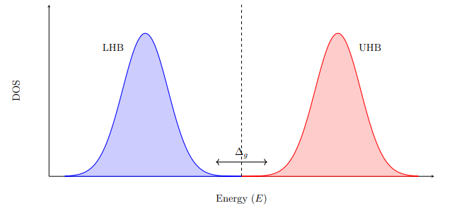
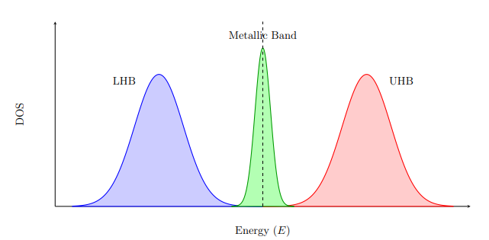
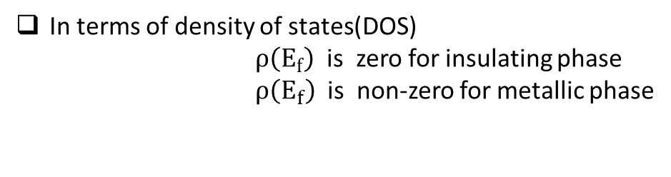
Mott Metal-Insulator Transition
In terms of density of states(DOS)
$ρ\left(E_{f}\right)$ is zero for insulating phase $ρ\left(E_{f}\right)$ is non-zero for metallic phase
As the DOS is zero at the fermi-level → Insulating Phase
There is metallic band or non-zero DOS at fermi-level→ Metallic Phase
3

Slide 4
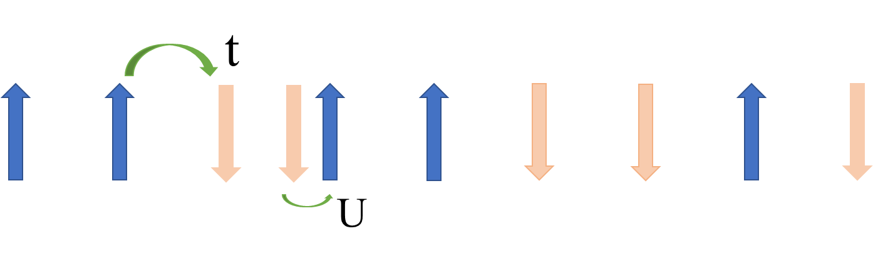

Hubbard Model
Essler, Fabian HL, et al. The one-dimensional Hubbard model. Cambridge University Press, 2005.
1D Hubbard model lattice chain
Mott metal-insulator transition can be visualized in this model when the on-site interaction energy (U) is greater than the hopping parameter (t).
4

Slide 5
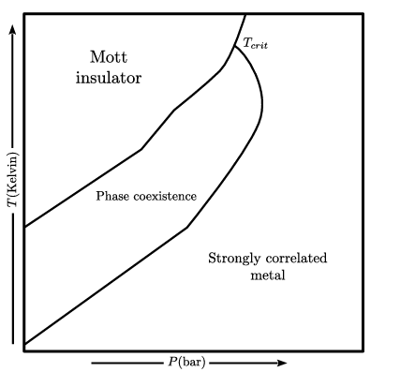
Hubbard Model
Experimentally we can’t increase U explicitly at each site
We can increase the pressure (P) applied on the material
Hubbard Model
Genuine Quantum Phase-Transition
Bilayer Model
Mott-Transition with respect to temperature (T) and pressure (P)
5

Slide 6
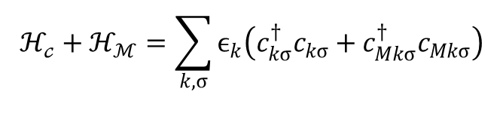
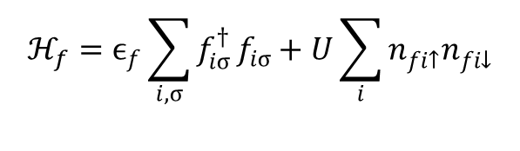
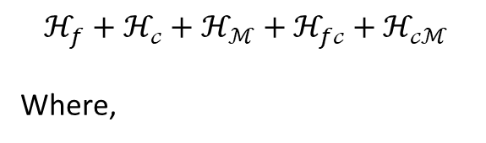
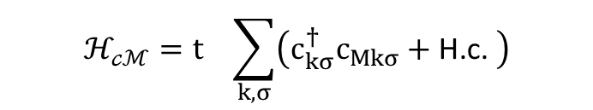
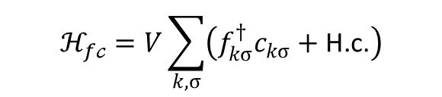
Bilayer Model
1. Sen, S. and Vidhyadhiraja, N.S., 2016. Quantum critical Mott transitions in a bilayer Kondo insulator-metal model system. Physical Review B, 93(15), p.155136. 2. Kulkarni, V.M., Vidhyadhiraja , N.S. and Sen, S., 2023. Emergent soft-gap Anderson models at quantum criticality in a lattice Hamiltonian within dynamical mean field theory. Physical Review B, 107(20), p.205104
The Hamiltonian for the Bilayer Model →
t
t
$$ℋ_{f}+ℋ_{𝒸}+ℋ_{ℳ}+ℋ_{f𝒸}+ℋ_{𝒸ℳ}$$ Where,
Non-Interacting Orbital (M)
t
t
V
V
V
$$ℋ_{f}=ϵ_{f}\sum_{i,σ}{f_{iσ}^{†}}f_{iσ}+U\sum_{i}{n_{fi↑}^{}n_{fi↓}^{}}$$
Conduction Orbital (C)
$$ℋ_{𝒸}+ℋ_{ℳ}=\sum_{k,σ}{ϵ_{k}\left(c_{kσ}^{†}c_{kσ}+c_{Mkσ}^{†}c_{Mkσ}\right)}$$
V
V
V
f Orbital
$$ℋ_{f𝒸}=V\sum_{k,σ}{\left(f_{kσ}^{†}c_{kσ}+\text{H}\text{.}\text{c}\text{.}\right)}$$
U
U
U
$$ℋ_{𝒸ℳ}=t_{}\sum_{k,σ}{\left(c_{kσ}^{†}c_{Mkσ}+\text{H}\text{.}\text{c}\text{.} \right)}$$
Schematic diagram of the Bilayer Model
6

Slide 7

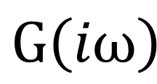
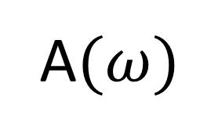
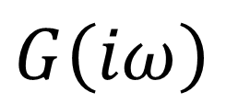
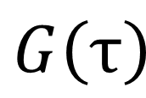
Analytic Continuation Process
3. Song, T. and Lee, H., 2019. Accelerated continuous time quantum Monte Carlo method with machine learning. Physical Review B, 100(4), p.045153.
To solve this kind of Hamiltonian we generally use some quantum impurity solver like Iterated Perturbation Theory(IPT) solver or Continuous Time Hybridization Expansion solver(CTHYB) used within Dynamical Mean-Field Theory (DMFT) framework .
4. Gull, E., Werner, P., Millis, A. and Troyer, M., 2007. Performance analysis of continuous-time solvers for quantum impurity models. Physical Review B—Condensed Matter and Materials Physics, 76(23), p.235123.
This kind of solver provide us Green’s function of imaginary time $G\left(τ\right)$.
$$G\left(τ\right)$$
Fourier Transformation
$G\left(iω\right)$
To get some real physical parameter we need this imaginary frequency Green’s function $G\left(iω\right)$in real frequency domain $G\left(ω\right)$
$G\left(iω\right)$
Analytic Continuation
A$(ω)$
Spectral function →$A\left(ω\right)=−\frac{1}{π}\text{Im}[G\left(ω\right)]$
7

Slide 8
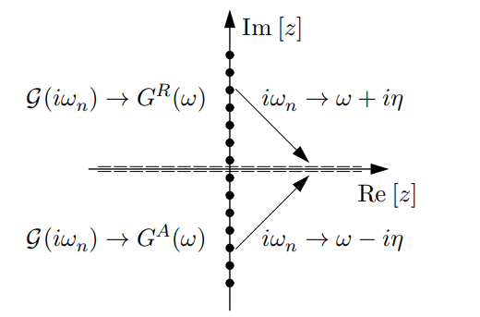
Analytic Continuation Process
Schematic diagram of the Analytic Continuation
5. Henrik Bruus and Karsten Flensberg. Many-body quantum theory in condensed matter physics , an introduction, 2004
8

Slide 9

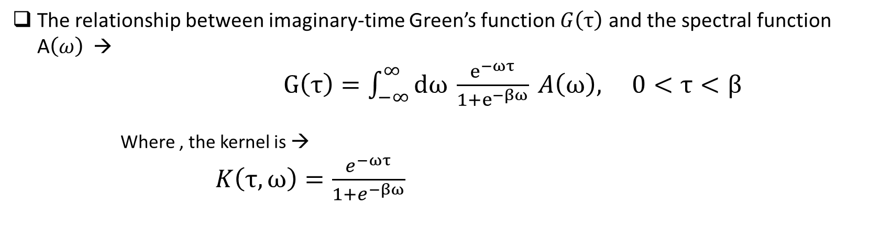



Analytic Continuation
The relationship between imaginary-time Green’s function $G\left(τ\right)$ and the spectral function A$\left(ω\right)$ → $G\left(τ\right)=\int_{−∞}^{∞}{dω} \frac{e^{−ωτ}}{1+e^{−βω}} A\left(ω\right), 0<τ<β$
Where , the kernel is → $K\left(τ,ω\right)=\frac{e^{−ωτ}}{1+e^{−βω}}$
Problems of Analytic Continuation →
Ill-posed solution : small error in $G\left(τ\right)$ leads to large fluctuation in $A\left(ω\right)$
$$A1(ω)$$
One to many mapping : $G\left(τ\right)$
$$A2\left(ω\right)$$
$$A3\left(ω\right)$$
Analytic Continuation Process → Pade's Approximation ,Maximum Entropy Method ,etc
7. Annam´aria Kiss. Self-energy pad´e approach for analytic continuation: Application tothe zero-gap kondo lattice model. Physical Review B, 100(21), December 2019.
9

Slide 10
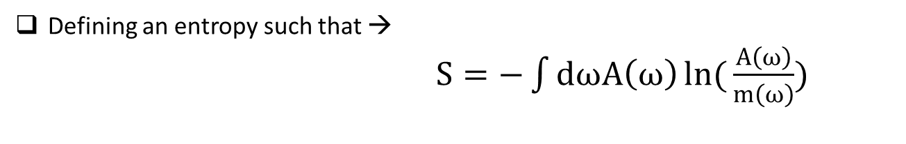
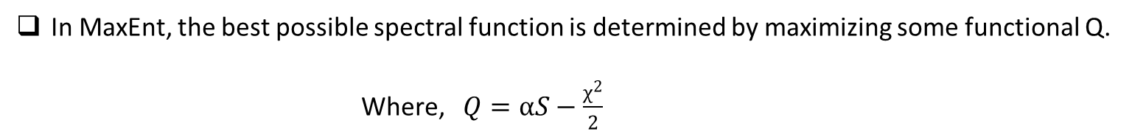

Maximum Entropy Method(MaxEnt)
Jarrell, Mark, and James E. Gubernatis. "Bayesian inference and the analytic continuation of imaginary-time quantum Monte Carlo data." Physics Reports 269.3 (1996): 133-195.
Spectral function $A\left(ω\right)$ can be interpreted as a probability distribution.
Defining an entropy such that → $S=−\int{dωA\left(ω\right)\ln{(}\frac{A\left(ω\right)}{m\left(ω\right)})}$
Where , $m\left(ω\right)$ is the default module
The entropy is maximized when A(ω) = m(ω).
Becomes more negative as probability distribution deviates from default module.
In MaxEnt, the best possible spectral function is determined by maximizing some functional Q. Where, $Q=αS−\frac{χ^{2}}{2}$
$α$ is the regularization parameter and $χ$ is a trial spectral function.
10

Slide 11
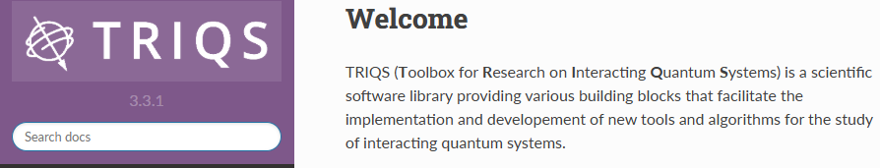
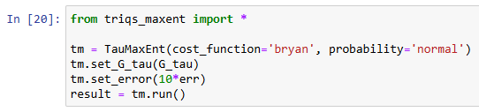
TRIQS
For my thesis, I have used TRIQS (Toolbox for Research on Interacting Quantum Systems) provided MaxEnt package.
Provides all necessary building blocks to study interacting quantum system →
Impurity Solver(like IPT,CTHYB ,etc.)
Analytic Continuation(like pade’s approximation ,maxent ,etc.)
AB-Initio Tools
<-- Some part of the TRIQS provided MaxEnt code
11

Slide 12
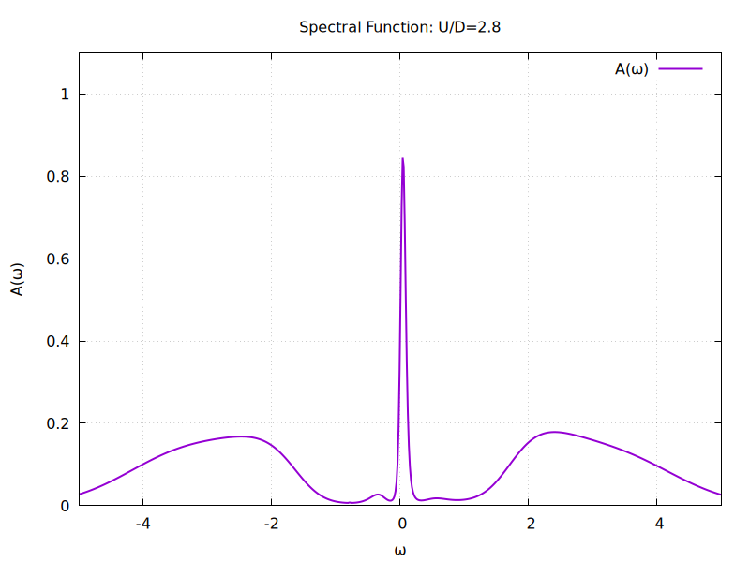
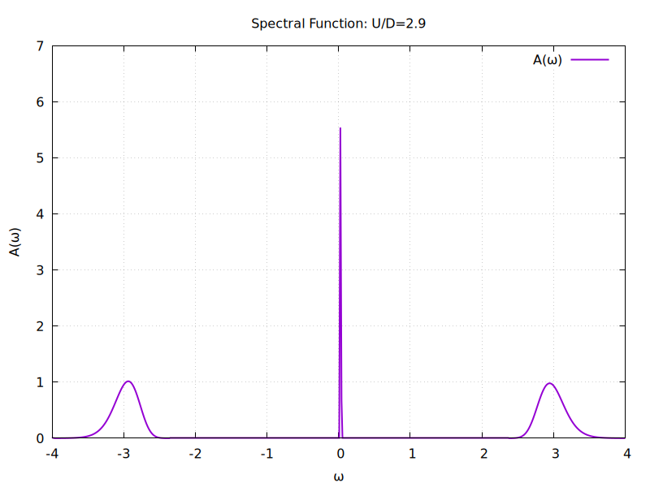
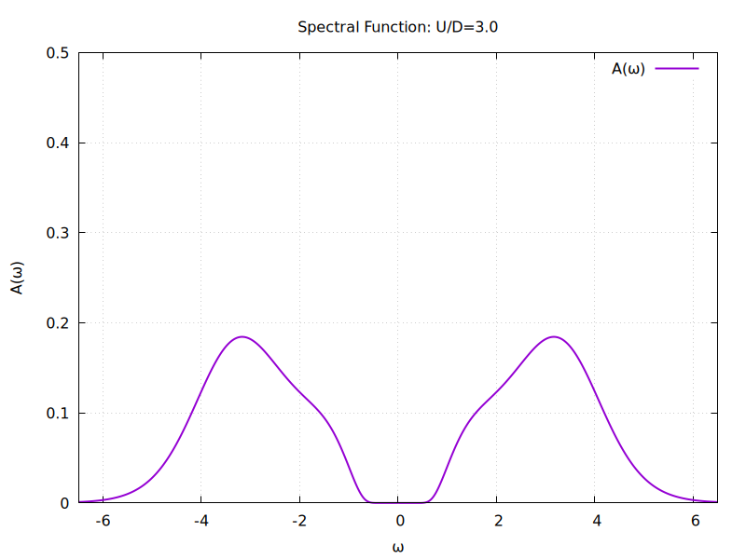
Result(Visualization Of Mott-Transition)
Mott-Transition in Hubbard Model
Spectral function of Hubbard Model using MaxEnt, for different values of U/D.
As the U/D ratio increasing the material becomes more and more insulation.
We can observe the transition point using MaxEnt.
12

Slide 13
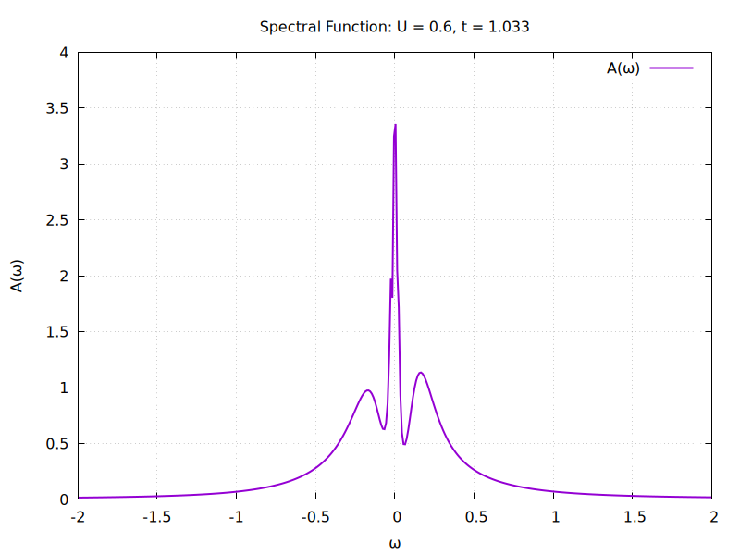
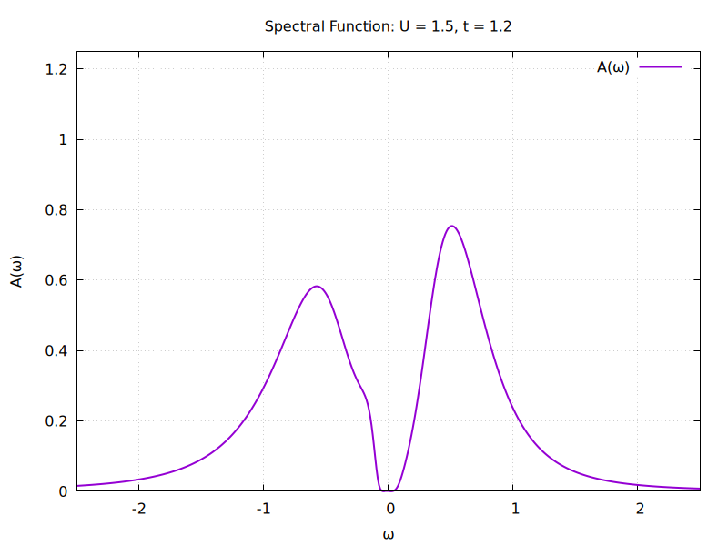
Result(Visualization Of Mott-Transition)
Mott-Transition in Bilayer Model
Spectral function for Bilayer Model using MaxEnt , for different U values
As the U value increases the material becomes more and more insulating
13

Slide 14
Conclusion
In this thesis I have calculated the spectral function for the Bilayer Model with the help of the TRIQS provided MaxEnt package.
MaxEnt providing better accuracy than the other method like Pade’s approximation.
Form the plots of the spectral functions it is clear that material will shift from metallic-phase to insulating –phase as the on-site interaction energy (U) get increased
Through this project I have learned to operate Lunex , Gnuplot , etc.
14

Slide 15
Thank You
15

Slide 16
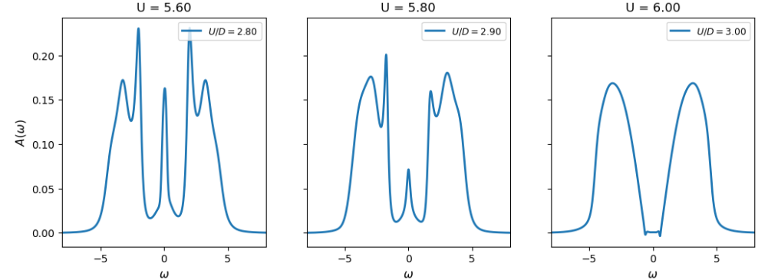
Extra Slide
Mott-Transition In Hubbard Model Using Pade’s Approximation
Spectral Function Of the Hubbard Model
16

